Slide 1
Stage 2: Growing our own ingredients

Slide 2
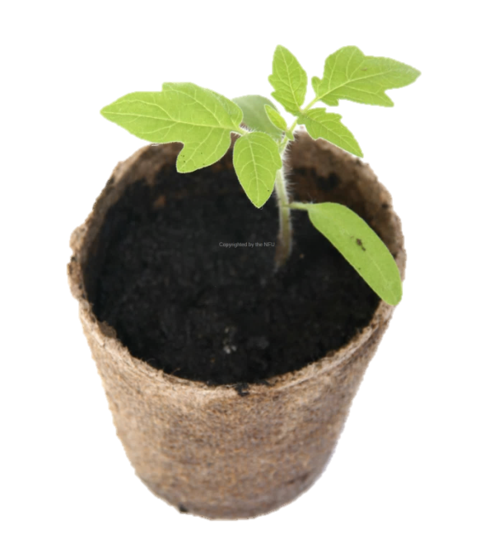
Learning Objectives:
To grow herbs from seeds
To write a shape poem
Talk to your partner: what do plants need to grow?
What is a herb?

Slide 3
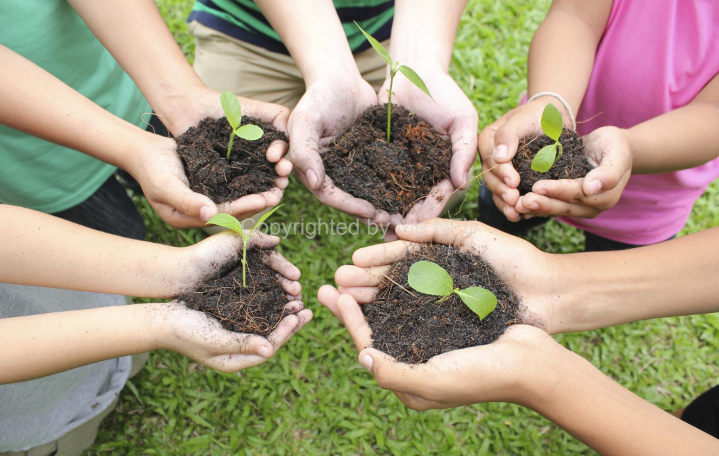
In order to grow healthy crops that we can use to make our lunchtime food product, we need to make sure that they have the following things:
Air
Light
Warmth
Water
Nutrients

Slide 5
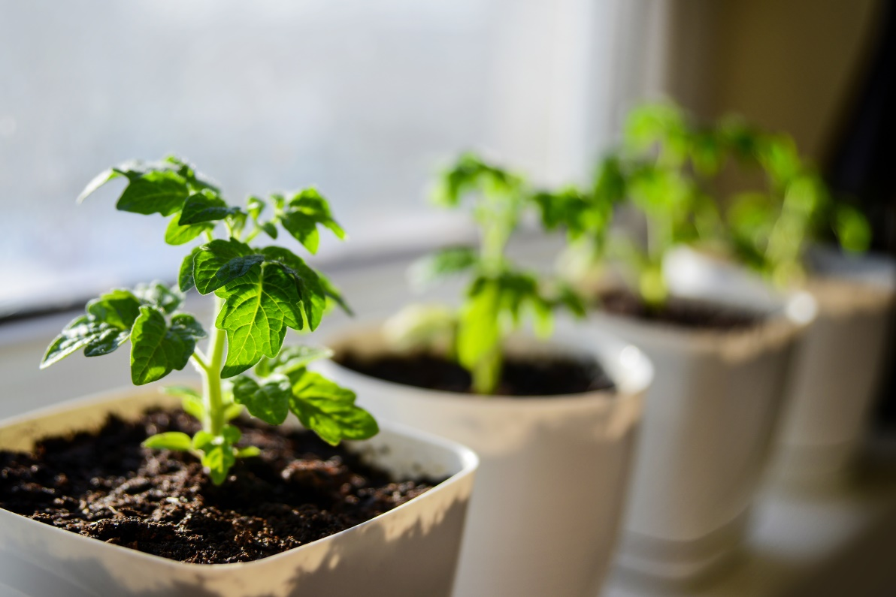
Where would be the best place in the classroom for us to keep our plants so that they have all the things they need to grow?

Slide 6
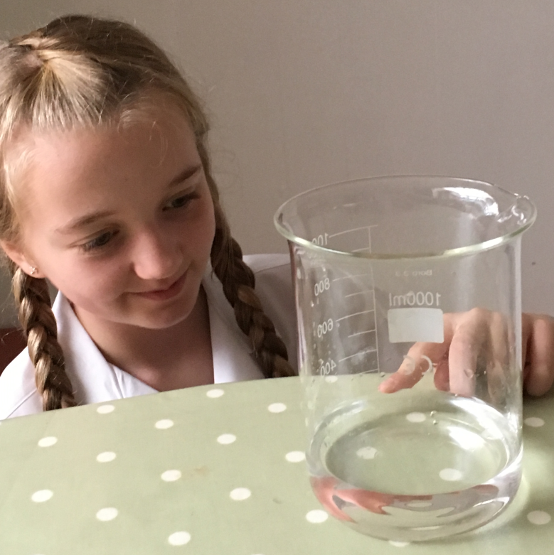
How do we measure water accurately?

Slide 7
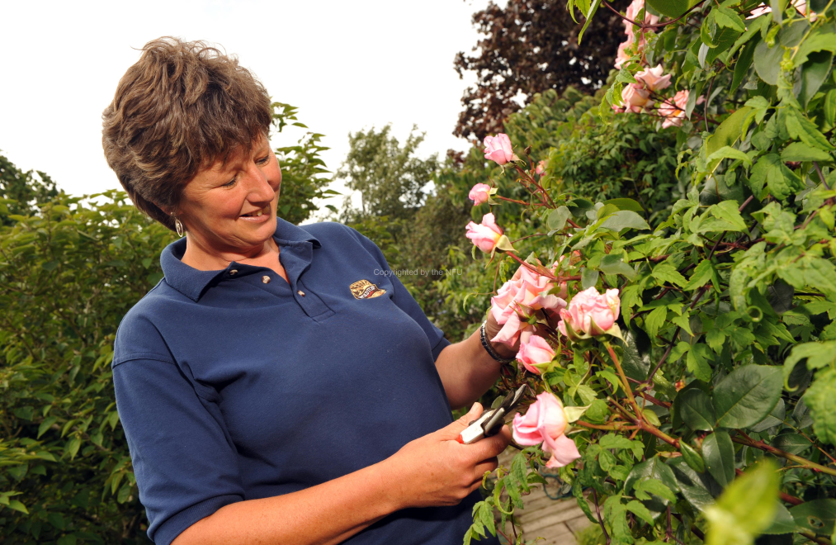
We need to make sure we water our crops just the right amount and look after them well.
Why?
Why do you think it is important for farmers to take really good care of their crops?

Slide 8
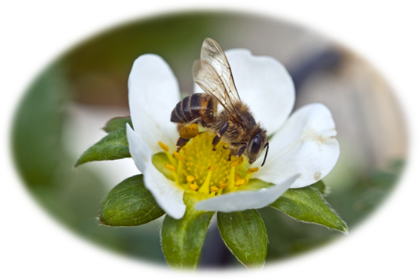
We are going to write a poem to use in the advertising for our business.
Watch the video clips carefully to inspire your poetry!
https://www.youtube.com/watch?v=LICDb8nM5rs
https://www.youtube.com/watch?v=eKo5F87A8a0

Slide 9
Your poetry toolkit
Powerful adjectives- use a thesaurus!
Similes
Metaphors
Personification
Alliteration
A range of verbs e.g. peeking, dancing, emerging, stretching
Rhythm
Rhyme??
Repetition

